Slide 1
Disability in the Workplace: Assets not Problems
Taking a fresh look at ways of improving the effectiveness of individuals and businesses

Slide 2
The speakers
Dr Phil Friend OBE FRSA Chair Disability Rights (UK)
John Gillman LLB (Hons), ACll, FRSA Consultant to the Board of Trustees Disability Rights (UK)

Slide 3
Quick Quiz
1) What proportion of disabled people are born with a disability?
a)27% b)37% c)17%
2) What percentage of disabled people use a wheelchair?
a)29% b) 8% c) 36%
3) What percentage of disabled people are unemployed
a) 19% b) 43% c) 28%
Notes:
Stats are from Papworth Trust
Employment rate from 2012 Labour Force Survey
Question 1 17%
Question 2 8%
Question 3 43%

Slide 4
Background
What do we mean by ‘disability’
Times they are ‘a changing for better or for worse!
The importance of work
Notes:
Define disability not illness use the legal definition.
Use the ship pictures to illustrate improvements as well as what still needs to change. The devil is in the detail.
Work is good for you. Status independence companionship a resaon for being.

Slide 5
Workplace Environment
John Gillman

Slide 6
The main components
Probabilities
The role of employee benefits
Barriers to success
The role of attitudes
The importance of language

Slide 7
Probabilities
Risk
Chance
Likelihood
and approaches to their management
Notes:
The way we use language is important.
Risk management:
Quantify
Ignore
Minimise
Transfer
The ageing workforce (GRiD research)
Earlier diagnosis
Better survival rates
Gradual end of mental health stigma

Slide 10
Benefits
The motivation to provide ‘benefits’
Reactive health related benefits
Risk management
Reward driven
Engagement driven
All three
It’s often useful to ask …..
what do we do, what does it cost, does it work and how do we know it works?
Salary continuation (uninsured)
Income protection (insured)
Private medical insurance
Ill-health early retirement benefits
Notes:
Benefits are, for example, legacy driven.
The move to Flexible Benefit schemes has really shaken things up.
Innovative thinking about:
IP (limited term)
PMI (Cancer)
Funding (trusts)

Slide 11
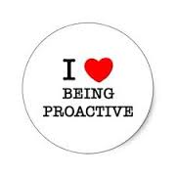
Pro-active programmes
‘Wellness’
Absence tracking
Early intervention initiatives
Employee Assistance Programmes
Occupational Health
Management training
Notes:
To what extent do these actually help avoid someone with a disability falling out of work?

Slide 12
Barriers to success
Diversity of responsibilities
Shortage of resources
Lack of actionable data
Distraction
Knowing where to go for help
The human factor
Notes:
Silo structures – OH, HR, Benefits Manager, Risk Manager, Pensions manager etc.
Data can be key but is often unavailable or in poor formats
Distraction – there is always other work to do if you are a line manager
The human factor and the ‘halo’ effect

Slide 13
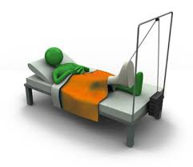
Attitudes to long term absence
Sympathy
Impatience
Annoyance
Alienation
Replacement
Dismissal
Notes:
Not the case every time but it’s important to know how the person is viewed by their manager and peers

Slide 14
Likelihood of return to work
After 6 months lower than 50%
After 12 months lower than 30%
After 24 months lower than 10%
Factors include the nature of the condition and the emergence of co-morbid problems
The benefits of work and the bio psychosocial model
Notes:
The requirement for reasonable adjustments and very early intervention.

Slide 15
Changing the way we speak and think about benefits
The deferred period
Limited benefit payment period
Notes:
Words can be loaded with meaning – both positive and negative

Slide 16
How about
The ‘getting you back to work period, and
The ‘removing the barriers’ period’

Slide 17
It is important to remember
It is possible to be disabled, but not sick ….. and
Sick but not disabled
Conventional approaches to ‘managing absence’ can be counter-productive
Notes:
Handover to Phil for case studies

Slide 18
Disabled employee effectiveness
Phil Friend

Slide 19
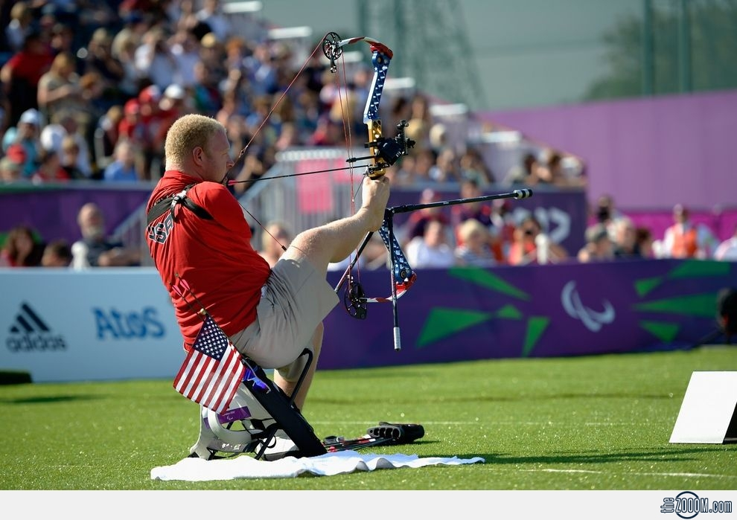
Typical Challenges with Reasonable Adjustment Process
Complexity
Line Manager engagement
Length of time to implement
Engaging with disabled employees
Costs
Notes:
Picture of Matt Saltzman Paralympic Archer and some elastic bands some adjustments are complex and require real skill others are pretty straight forward.

Slide 20
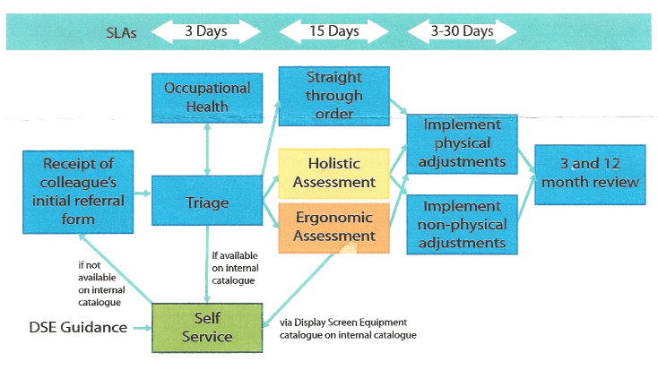
Adjustment Process Map
Notes:
Process map of a suggested reasonable adjustment process

Slide 21
Lessons we’ve learned
Act early don’t wait
Differentiate between managing performance and managing disability
Recognise the need for ‘hard’ and ‘soft’ adjustments
Recognise that providing adjustments is about effective performance
Develop advance directives for all
Non-visible and fluctuating conditions
Empower the individual
Train Mental Health First Aiders
Notes:
Act Early
Research suggests that acting early is extremely important in order to ensure that we keep people in work
Differentiate
Work on being clear that you can see how the disability is effecting performance and explore adjustments to increase effectiveness. This is different from the disabled individual using the impairment as an excuse to avoid tasks they simply don’t want to do.
Hard and Soft Adjustments
Physical adjustments are tangible and generally easier to accommodate. Soft adjustment are trickier. They can involve changing working patterns, targets, start and finish times, working from home etc. They can impact on other colleagues who may not understand why ‘preferential treatment’ is being given as they may not know the individual is disabled
Effective performance
The main reason for providing adjustments is to improve an employees performance. It makes no sense to refuse adjustments if the benefits outweigh the costs.
Advance Directives
Explain that an AD is about preempting the impact of an impairment. Agreeing how to manage someone who has a mental health condition or other fluctuating condition before they are ‘ill’ makes real sense.
Non-visible and fluctuating conditions
Non-visible and fluctuating conditions are the most difficult to manage for the employee and employer. Advance directives can help.
Empower the individual
Really helps to encourage the disabled person to share how best to manage things what helps what doesn't’t. Asking the individual to write a one pager which says what their condition is, how it effects them and what helps or hinders is really useful. If this can be shared with immediate colleagues it can really help.

Slide 22
Solutions
Identify a trusted partner
Keep the process simple
Centralise funding
Develop an online assessment process
Develop a simple speedy ordering process
Follow up regularly
Develop line managers reasonable adjustment guide which covers ‘hard’ and ‘soft adjustments
Develop workplace adjustment ‘passports’

Slide 23
Key things to take away
Adjustments are about improving effectiveness
Line managers need support to understand their obligations
Keep processes simple
Engage disabled employees every step of the way.
Act quickly
Dispel the myths around costs.
Provide appropriate training for colleagues
Develop processes to manage fluctuating conditions

